Slide 1
Formal Specification and Verification of an ATM Machine
Submitted By:
2020-SE-01 Muhammad Talha
2020-SE-04 Qamar ul Zaman
2020-SE-12 Haider Ali Faizi

Slide 2
Introduction
ATM systems are a typical example of a safety-critical and real-time system. The ATM is the system that is used to access bank accounts to make cash withdrawals.
The ATM unit consists of a display screen, a card reader, a cash dispenser, and an envelope slot.
The card reader determines the account number from the entered card.
The user is prompted to enter a PIN after a card is entered. A menu is displayed with the options like Withdraw, Balance Inquiry, and Exit. The card is ejected when the session is completed.

Slide 3
Problem Statement
ATM system has a drastic change from the older working banking system, customer feel inconvenienced with the transaction method as it was in the hands of the bank employees.
In our ATM system, the problem is overcome here by the transactions done by the customer thus making customers feel safe and secure.
Therefore, the system helps the customer in checking the balance and transaction the amount by validating the PIN therefore ATM system is more user-friendly.

Slide 4
Objective
Safety
If a person is doing the transaction, then in the case of a mishap, like a light off, the person’s money remains in his/her account if he/she has not done the transaction.
Security
System checks the card whether the card is right or not.
Reach-ability
User can withdraw the amount.

Slide 5
Objective(Continue…)
Liveness
If a user enters the card, then the system allows selecting language i.e., the output of the given input.
Fairness
If a user wants to withdraw the amount infinitely, then the amount will be withdrawn till the limit is reached.
Reliability
If a user withdraws the amount, then the amount should be withdrawn the user has selected.

Slide 6
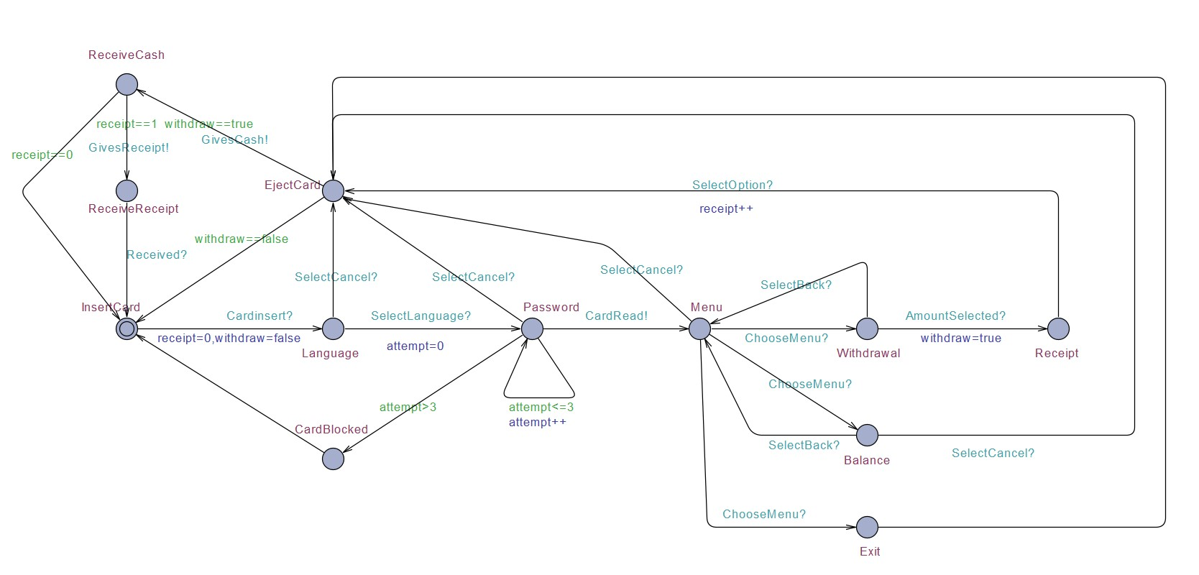
Implementation
Machine

Slide 7
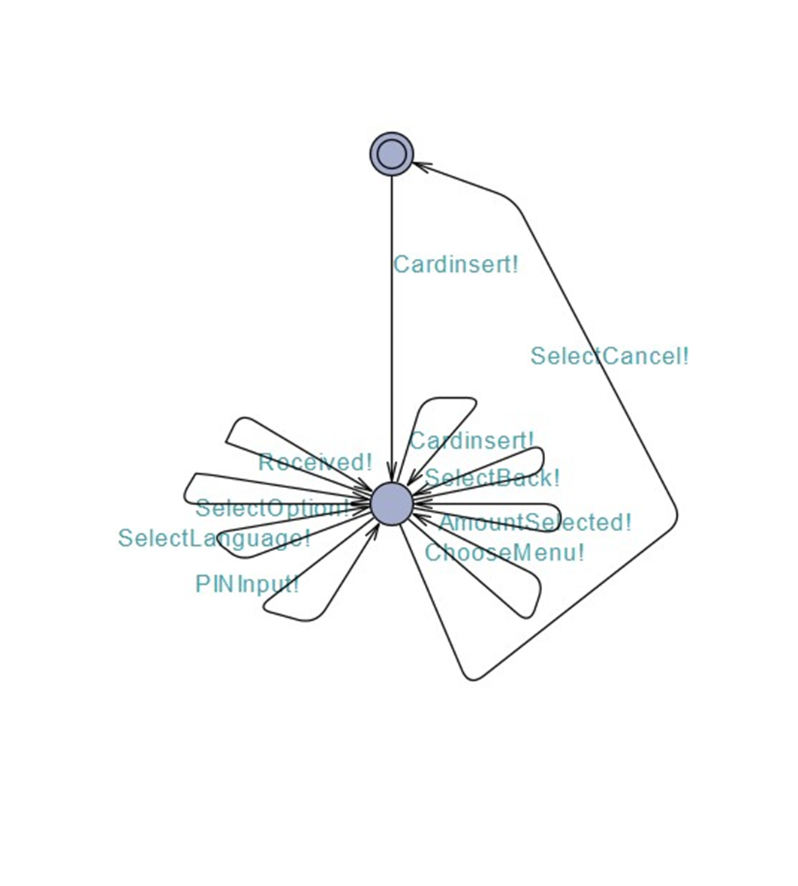
Implementation(Continue…)
User

Slide 8
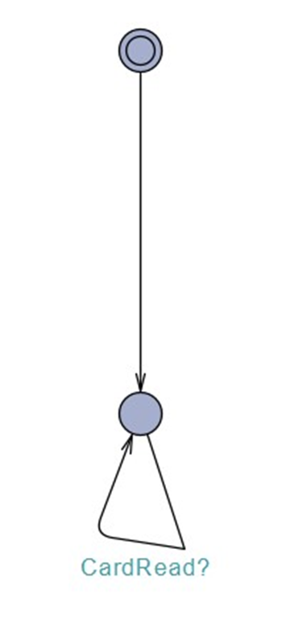
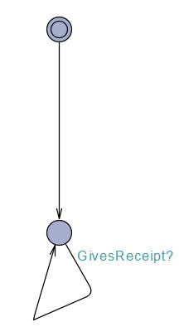
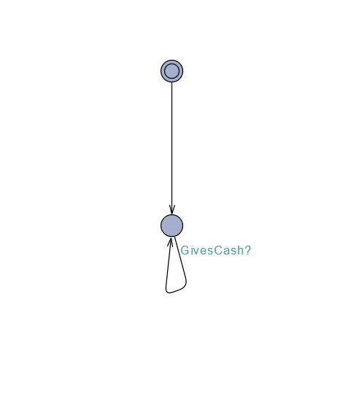
Implementation(Continue…)
Cash Dispenser
Cash Reader
Receipt

Slide 9
Formal Specifications
Informal | Formal | Results
There is no deadlock in our system. | A[] not deadlock | Satisfied
For all paths in our system, we will finally be able to insert the card again. | A⟨⟩ATMScreen.InsertCart== true | Satisfied
There exists a path in our system where we finally enter our password. | E⟨⟩ATMScreen.Password== true | Satisfied

Slide 10
Formal Specifications (Continue…)
Informal | Formal | Results
There exist a path in our system where finally our card will be blocked. | E⟨⟩(ATMScreen.Password implyATMScreen.CardBlocked == true) | Satisfied
There exist a path where we receive our cash after the card is received. | E⟨⟩(ATMScreen.EjectCard implyATMScreen.ReceiveCash == true) | Satisfied
There exist a path when you are on the password screen that it will again ask you to enter password. | E⟨⟩(ATMScreen.Password implyATMScreen.Password == true) | Satisfied

Slide 11
References
https://www.researchgate.net/publication/220636950_The_Formal_Design_Model_of_an_Automatic_Teller_Machine_ATM
https://acknowledgementletter.com/acknowledgement-for-engli
https://www.academia.edu/9309171/The_Formal_Design_ Model_of_ATM

